Slide 1
Heisenberg’s Uncertainty Principle

Slide 2
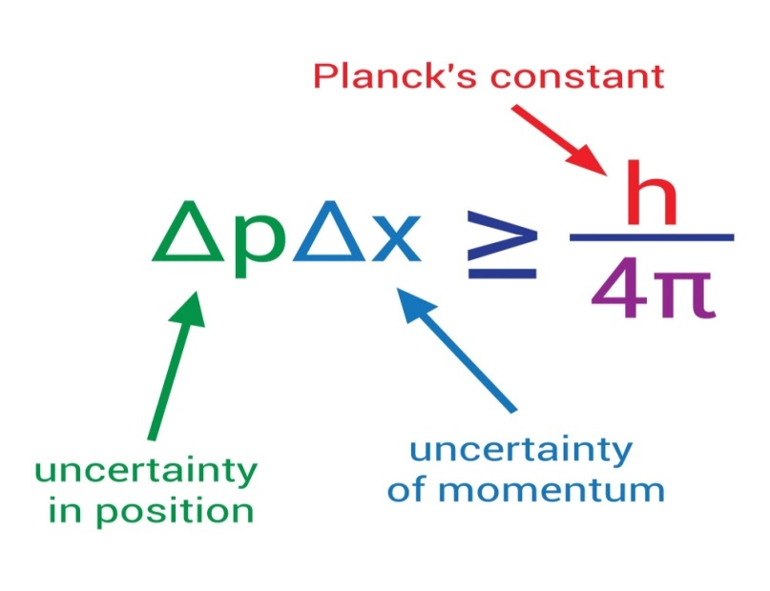
Definition
The position and the velocity of an object cannot both be measured exactly, at the same time.

Slide 3
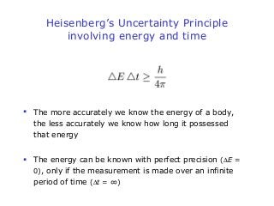

Slide 4
Derivation of Equation
Consider group of waves, with two waves of equal amplitude a, frequencies ω _{1 ,}ω ₂ and Propagation constants k_{1 ,}k₂
Ѱ₁ = a sin (ω ₁t - k₁x)
Ѱ₂ = a sin (ω ₂t - k₂x)

Slide 5
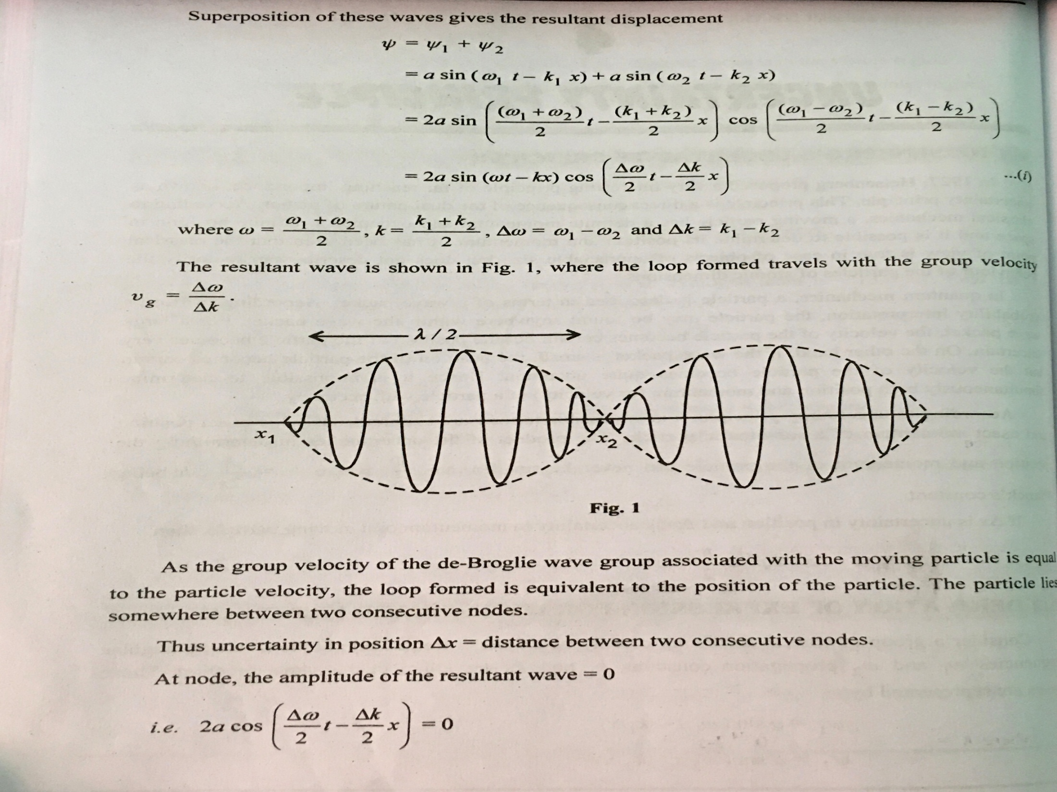

Slide 6
